Slide 1
Final Presentation
Team Coyote2

Slide 2
CONTENTS
01
02
03
Team Members
Introduction
Methodology
04
05
06
Results
Conclusion
Experiment
Discussion

Slide 3


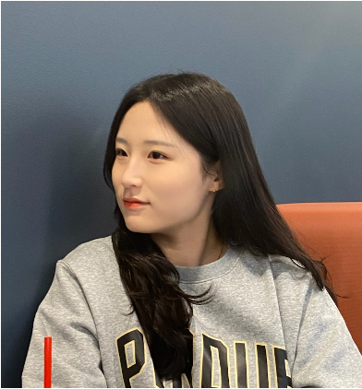




Team Member
Yejin Lee
Heesun Jung
Youngbin Kim
Computer Science
Hallym University
Computer Science
Hallym University
Computer Engineering
Kwangwoon University
Bokyung Kwon
Jihyeon Park
Griffin Pegg
Computer Engineering
Kwangwoon University
Computer Science
Jeju National University
CNIT
Purdue University

Slide 4

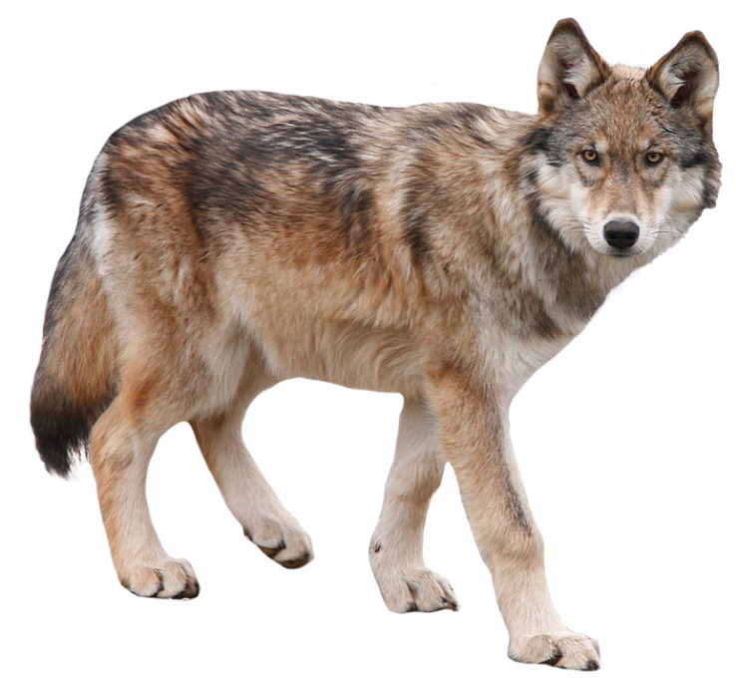
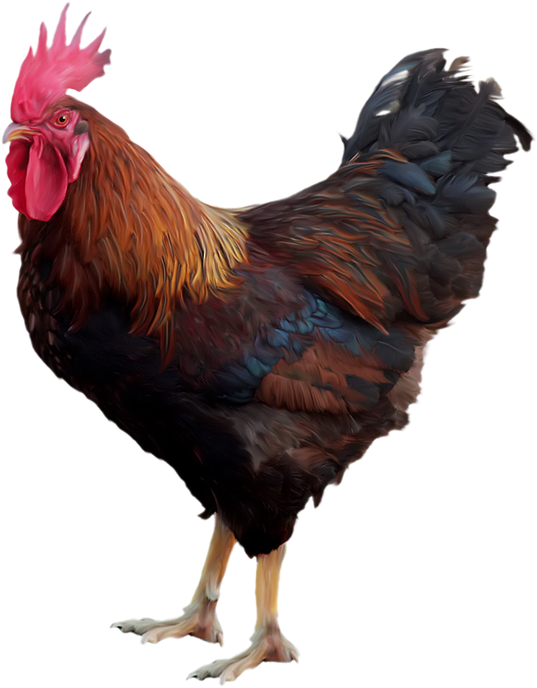
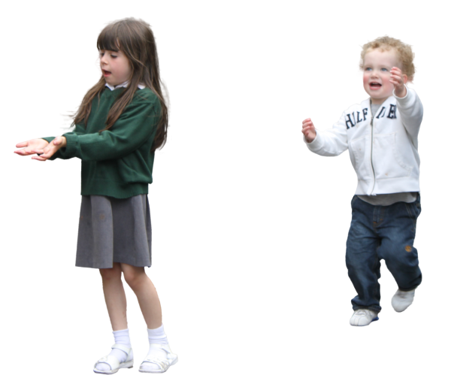
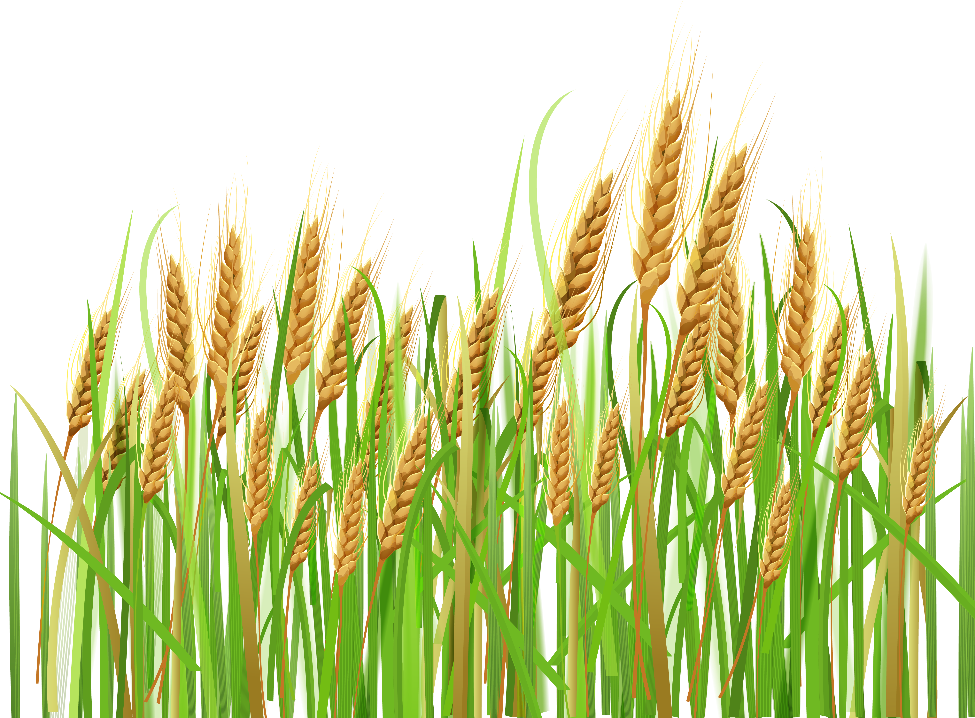
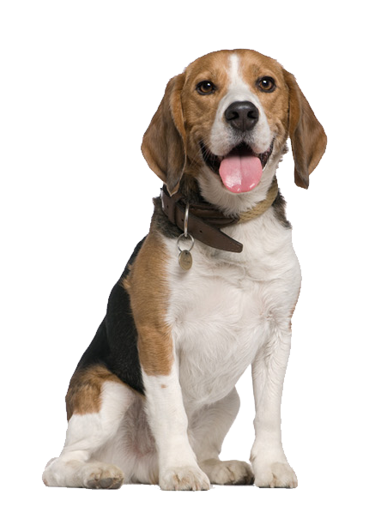
Introduction
There is substantial damage to livestock, human costs, and crops
by coyotes in several farms.
Continuous Economic Losses

Slide 5
Introduction
The number of livestock killed by coyotes among those killed by predators
[USDA, 2015]
But solving the problem with.. Non-technical approach
Technical Approach
is needed.

Slide 6

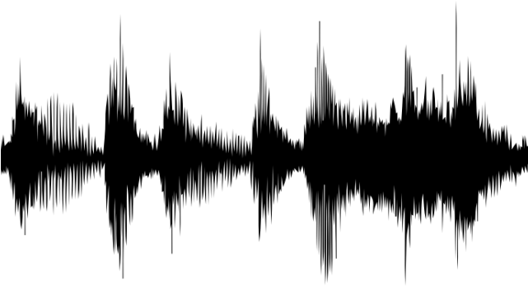
Introduction
💡 Project Overview
Raspberry Pi
MODEL
Localization
Part
LoRaWAN
GATEWAY
Raspberry Pi
Raspberry Pi
MODEL
MODEL

Slide 7


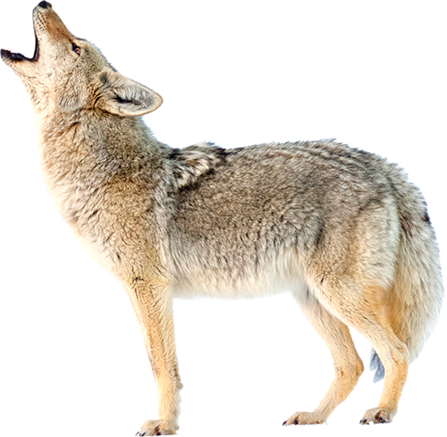
Introduction
💡 Coyote sounds
- Coyotes have a habit of making frequent howling.
- Coyotes barking, howling, yipping …
Howling
Barking
AUDIO
Yipping

Slide 8
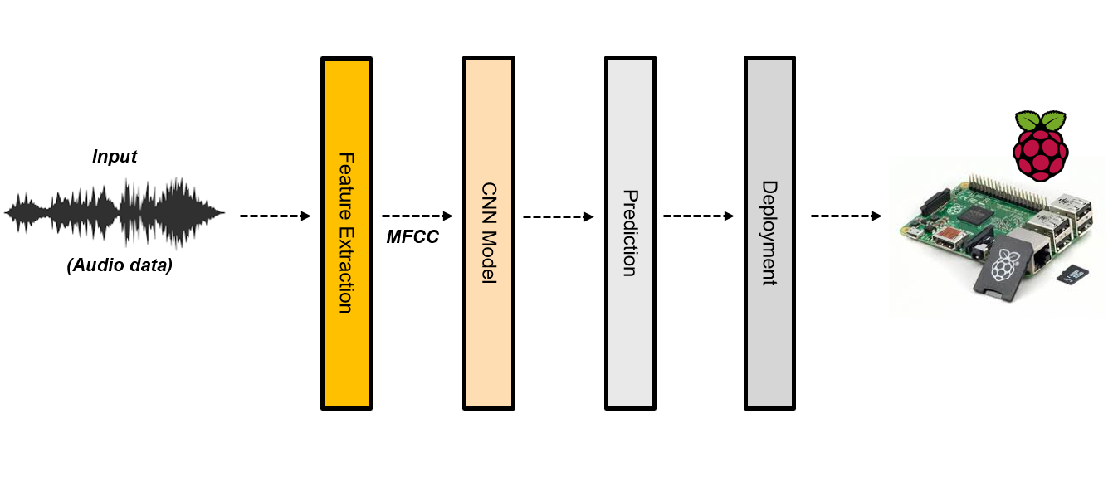
Methodology
💡 Overall Architecture
Feature Extraction
Model
Prediction
Deployment
• MFCC
• GTCC
• Mel Spectrogram
• Log-Mel Spectrogram
• CNN
• MLP
• KNN
• SVM
• GNB

Slide 9
Methodology
💡 Feature Extraction
Mel Spectrogram
➡ A spectrogram where the frequencies are converted to the Mel scale
Gammatone Cepstral Coefficient(GTCC)
➡ Use a gammatone filter to extract an audio feature
➡ Use discrete cosine transform (DCT) to reduce the dimension of audio feature
Log-Mel Spectrogram
➡ A spectrogram where log scaled Mel spectrogram
Mel Frequency Cepstral Coefficient(MFCC)
➡ One of the most broadly used methods in audio recognition.
➡ Apply Filter Bank based on Mel Scale on Spectrum

Slide 10


Methodology
💡 Audio processing in Python
- Extract features from sound files
- Different signal processing library that visualize the audio signals and feature extraction
- Used for MFCC, Mel-Spectrogram, Log-Mel Spectrogram
- Simplify extract features from mono sound files
- Light weight library that unite audio feature extraction algorithms in one simple code
- Used for GTCC

Slide 11
Experiment – Dataset
💡 Dataset Component
[The number of TOTAL DATA]
Coyote |  | 1,935
Non-Coyote | Dog | 503
 | Chicken | 593
 | Fox | 201
 | Bird | 597
Total |  | 3,829
1,894
[The number of each task]
Train data (60%) | Validation data (20%) | Test data (20%)
2,297 | 766 | 766

Slide 12




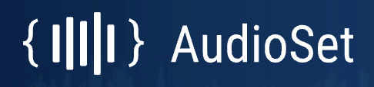
Experiment – Dataset
💡 Dataset source
Coyote / Fox
Dog / Chicken
Bird
National Park Service
/ Macaulay Library
Google research Audio dataset
birdCLEF 2021
For model training, the dataset should be clear.
Manually preprocessed and split each file for 3 seconds.

Slide 13
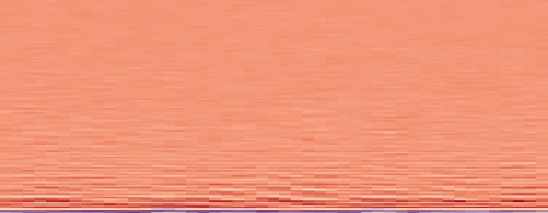
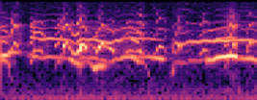
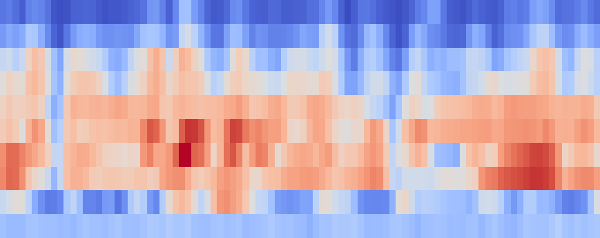
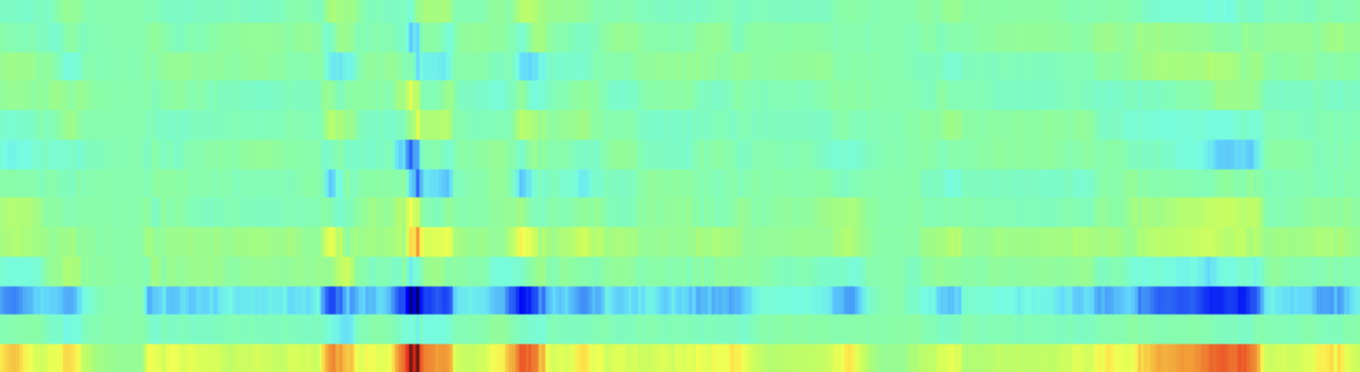
Experiment – Experimental Setup
[ Machine Learning Model ]
[ Feature Extraction Methods ]
MFCC
Mel Spectrogram
MLP
KNN
GNB
SVM
Log-Mel Spectrogram
GTCC
CNN
4-layer
CNN
3-layer
CNN
2-layer
[ Sampling Rate]
8,000 Hz, 16,000 Hz
7
x
4
x
2
= 56
Different
Experiments
Model
Feature Extraction Method
Sampling Rate

Slide 14
Experiment – CNN Model
💡 Convolutional Neural Network (CNN)
- Deep learning algorithm that detect different features using convolution layers
Conv 2D
Fc Layer
Yes
Conv 2D
Conv 2d
ReLU
Maxpool 2D
Conv 2d
ReLU
Maxpool 2D
Conv 2D
Conv 2d
ReLU
Maxpool 2D
No
[Model architecture]
Loss : CrossEntropyLoss | Optimizer : Adam | Learning Rate : 0.001

Slide 15
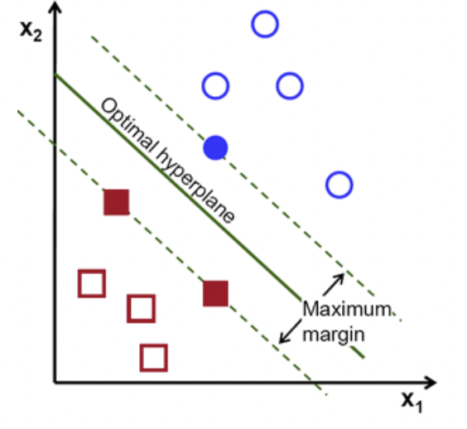
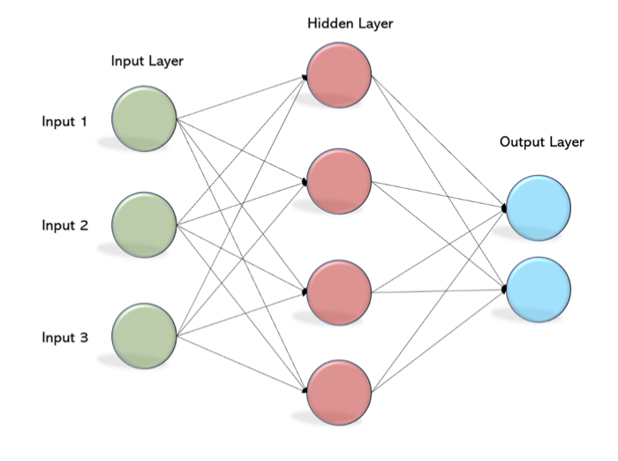
Experiment – Machine Learning Model
- SVM(Support Vector Machines)
- MLP(Multi-Layer Perceptron)
- When a new data point appears, it checks and classifies which side of the boundary the point belongs to.
- Fully connected feed-forward artificial neural network

Slide 16
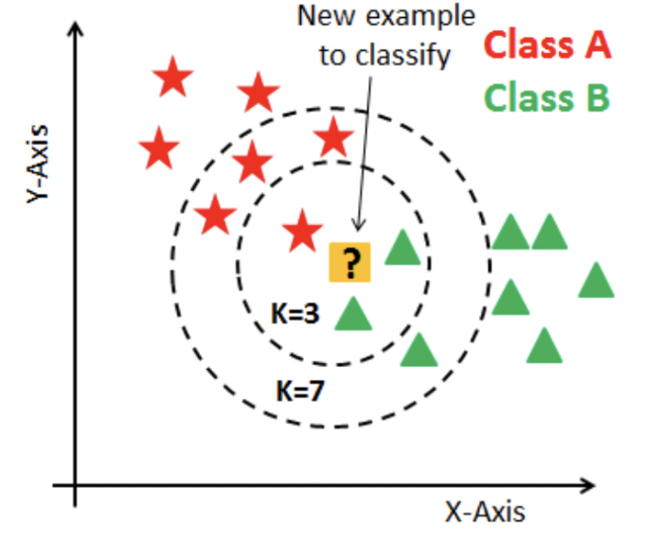
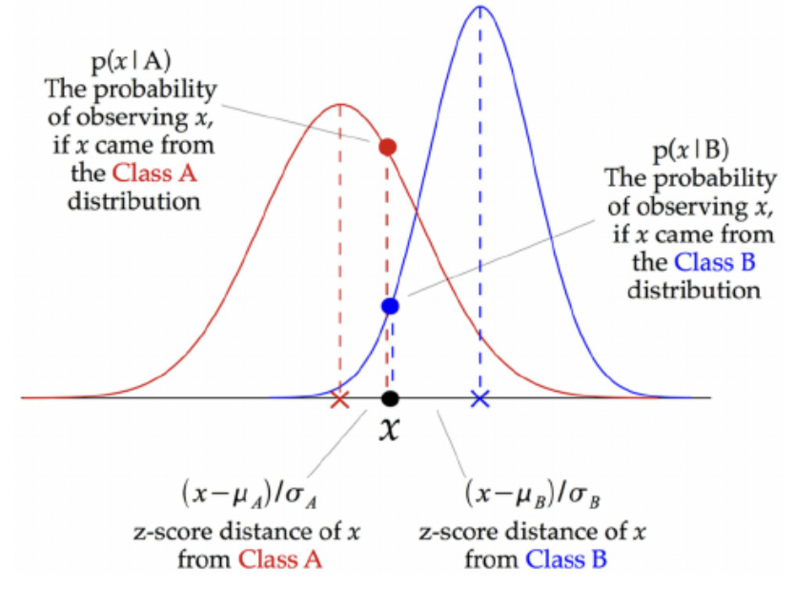
Experiment – Machine Learning Model
- KNN(K-Nearest Neighbors)
- GNB(Gaussian Naive Bayes)
- Selects and Classifies the point that is close to each other, based on the distance between data according to the K value.
- Probabilistic classification model used for binary and multiclass problems
- Often used for text categorization

Slide 17
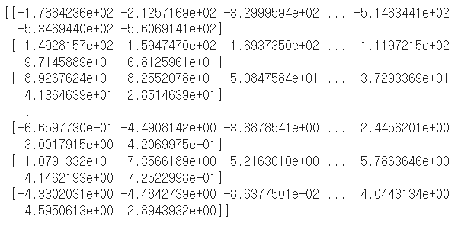
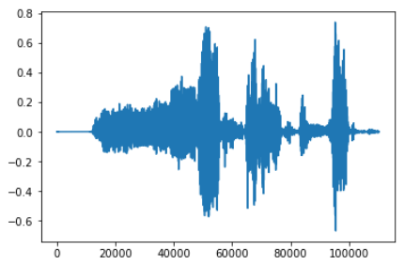
Experiment – Audio Classification
💡 1. Audio Feature Training
Feature Extraction
(MFCC, Mel Spectrogram,
Log-Mel Spectrogram, GTCC)
Raw wav file
Audio Feature
Sampling Rate
1)
2)
Using low sampling rates Data size becomes smaller

Slide 18
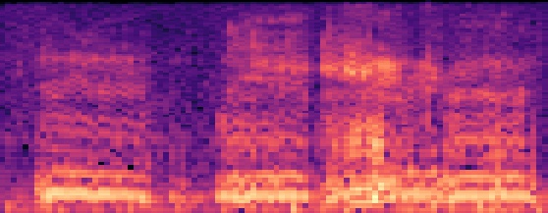
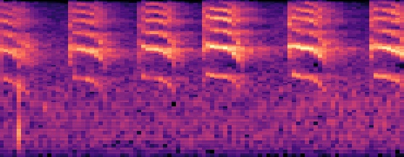
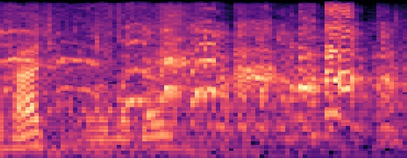
Experiment – Image Classification
💡 2. Image Feature Training
(a) Extracted feature in MFCC
Feature Extraction
(only MFCC, Mel Spectrogram)
Raw wav file
(b) Extracted feature in Mel Spectrogram
[Bird]
[Chicken]
[Coyote]
The mel-spectrogram image for each animal looks very different.

Slide 19
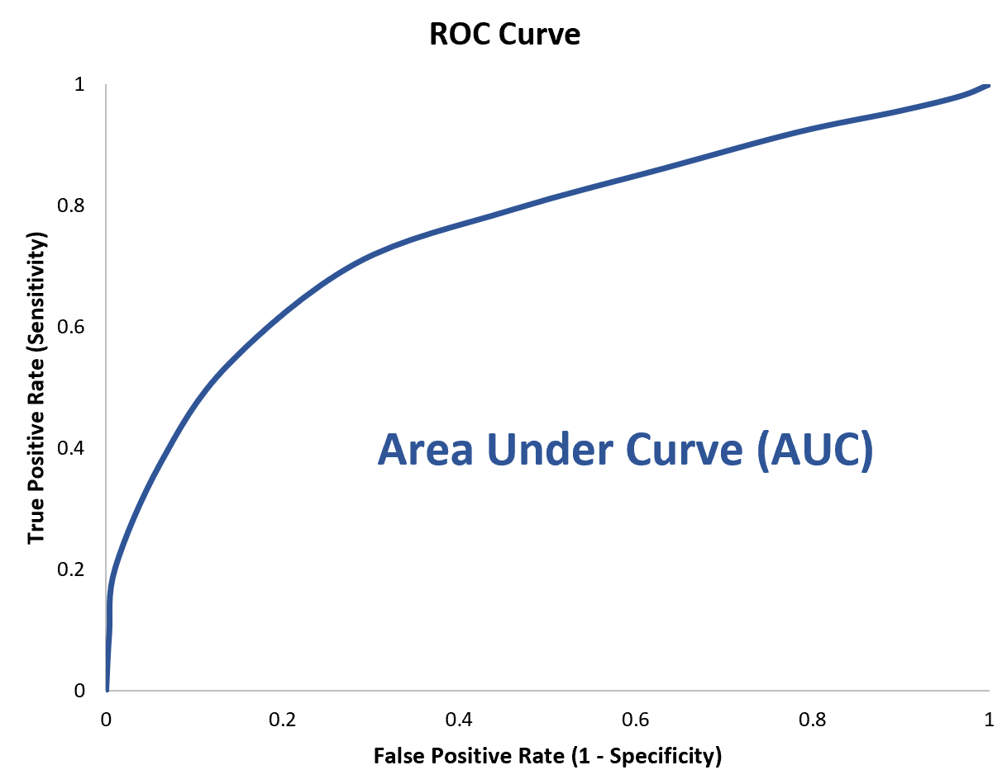
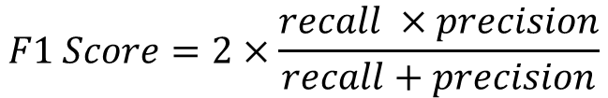
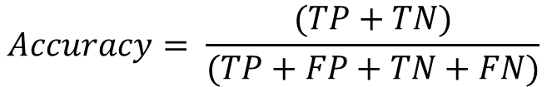
Result
💡 Evaluation Metrics
$$Accuracy= \frac{(TP+TN)}{(TP+FP+TN+FN)}$$
Accuracy
$$F1 Score=2×\frac{recall ×precision}{recall+precision}$$
F1 Score
AUC Curve

Slide 20
Result
💡 Total Result
Audio
Image
 | MFCC |  | Mel-spectrogram |  | Log-mel spectrogram |  | GTCC
Sampling Rate | 8000 | 16000 | 8000 | 16000 | 8000 | 16000 | 8000 | 16000
CNN/layer 4 | 0.92 0.93 0.9687 | 0.93 0.93 0.9792 | 0.85 0.86 0.927 | 0.83 0.85 0.8897 | 0.85 0.85 0.9416 | 0.88 0.88 0.9513 | 0.76 0.78 0.8226 | 0.81 0.81 0.8788
CNN/layer 3 | 0.90 0.91 0.96 | 0.96 0.96 0.9882 | 0.77 0.80 0.8537 | 0.78 0.81 0.8669 | 0.86 0.87 0.9382 | 0.87 0.88 0.9489 | 0.77 0.76 0.8048 | 0.80 0.80 0.8776
CNN/layer 2 | 0.86 0.87 0.93 | 0.93 0.93 0.9789 | 0.75 0.73 0.8421 | 0.79 0.77 0.8794 | 0.85 0.87 0.9189 | 0.85 0.86 0.9128 | 0.72 0.69 0.6378 | 0.73 0.74 0.6872
MLP | 0.84 0.85 0.9212 | 0.84 0.86 0.9272 | 0.63 0.71 0.7295 | 0.72 0.75 0.7573 | 0.85 0.87 0.9257 | 0.85 0.86 0.9273 | 0.74 0.75 0.7929 | 0.77 0.79 0.847
KNN | 0.82 0.82 0.8717 | 0.83 0.84 0.8777 | 0.70 0.72 0.7513 | 0.70 0.73 0.7512 | 0.83 0.83 0.8801 | 0.82 0.83 0.8881 | 0.66 0.68 0.7263 | 0.72 0.74 0.7815
SVM | 0.88 0.90 0.9496 | 0.90 0.91 0.9623 | 0.61 0.70 0.7195 | 0.86 0.87 0.9319 | 0.84 0.85 0.9182 | 0.85 0.86 0.9202 | 0.76 0.77 0.8526 | 0.80 0.80 0.875
GNB | 0.78 0.79 0.852 | 0.80 0.81 0.8486 | 0.61 0.70 0.606 | 0.63 0.71 0.631 | 0.68 0.70 0.7241 | 0.63 0.65 0.6631 | 0.62 0.68 0.6228 | 0.60 0.68 0.5944
MFCC |  | Mel-spectrogram
8000 | 16000 | 8000 | 16000
0.89 0.90 0.9605 | 0.90 0.90 0.9686 | 0.82 0.82 0.9053 | 0.92 0.92 0.8115
0.91 0.91 0.9496 | 0.91 0.91 0.9637 | 0.85 0.86 0.9347 | 0.93 0.93 0.9753
0.86 0.87 0.9346 | 0.87 0.87 0.9392 | 0.79 0.80 0.7912 | 0.81 0.82 0.8115
0.79 0.81 0.8805 | 0.81 0.81 0.9007 | 0.84 0.86 0.91 | 0.86 0.87 0.9342
0.81 0.82 0.8736 | 0.81 0.83 0.8663 | 0.82 0.83 0.885 | 0.82 0.80 0.8823
0.83 0.85 0.9065 | 0.85 0.87 0.9249 | 0.86 0.88 0.9481 | 0.89 0.91 0.9575
0.56 0.61 0.5656 | 0.50 0.59 0.5032 | 0.77 0.79 0.7696 | 0.71 0.75 0.7167
Best Combination
CNN Layer 3 MFCC - 16,000
Audio
CNN Layer 3 Mel Spectrogram - 16,000
Image

Slide 21
Result
💡 Comparison of the performance of Machine Learning Models
 | Accuracy | F1 Score | AUC Curve
Audio | 👍 CNN layer 3,4 0.96 Except Mel-spectrogram (16,000) – SVM | 👍 CNN layer 3,4 0.96 Except Mel-spectrogram (16,000) – SVM | 👍 CNN layer 3,4 0.9882 Except Mel-spectrogram (16,000), GTCC (8,000) – SVM
Image | 👍 CNN layer 3 0.93 Except Mel-spectrogram (8,000) – SVM | 👍 CNN layer 3 0.93 Except Mel-spectrogram (8,000) – SVM | 👍 CNN layer 3,4 0.9753 Except Mel-spectrogram (8,000) – SVM

Slide 22
Result
💡 Comparison of the performance of Feature Extraction Methods
 | Accuracy | F1 Score | AUC Curve
Audio | 👍 MFCC 0.96 Except MLP (Log-Mel) | 👍 MFCC 0.96 Except MLP (Log-Mel) | 👍 MFCC 0.9882 Except MLP, Knn (Log-Mel)
Image | 👍 Mel Spectrogram 0.93 Except CNN layer 2 (MFCC) | 👍Mel Spectrogram 0.93 Except CNN layer 2 (MFCC) | 👍 Mel Spectrogram 0.9753 Except CNN layer 2,4 (MFCC)

Slide 23
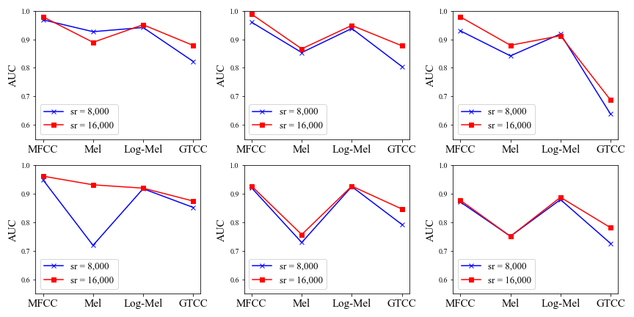
Result
💡 Sampling Rate : The graphs of each model’s AUC Curve
No huge difference between 8,000 and 16,000
CNN Layer 4
CNN Layer 3
CNN Layer 2
SVM
MLP
Knn

Slide 24
Conclusion
BEST : CNN Layer 3 + MFCC 16,000
Raspberry Pi
CNN
+ MFCC
Localization
Part
GATEWAY
Raspberry Pi
Raspberry Pi
CNN
+ MFCC
CNN
+ MFCC

Slide 25
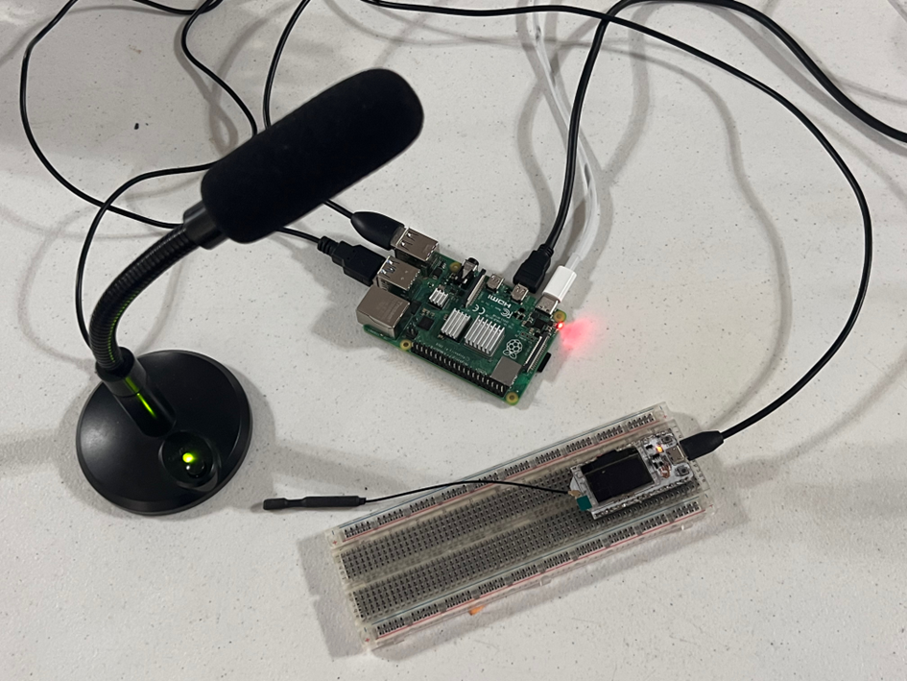
Demo

Slide 26
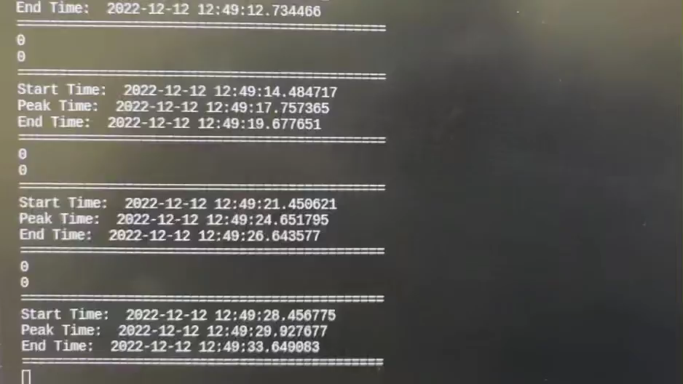
Demo
Coyote = 1 / Non-Coyote = 0

Slide 27
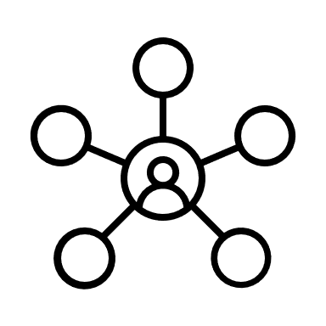
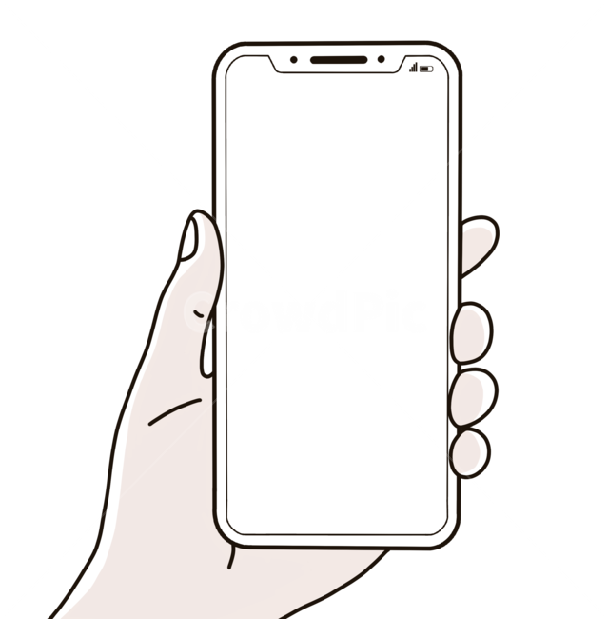
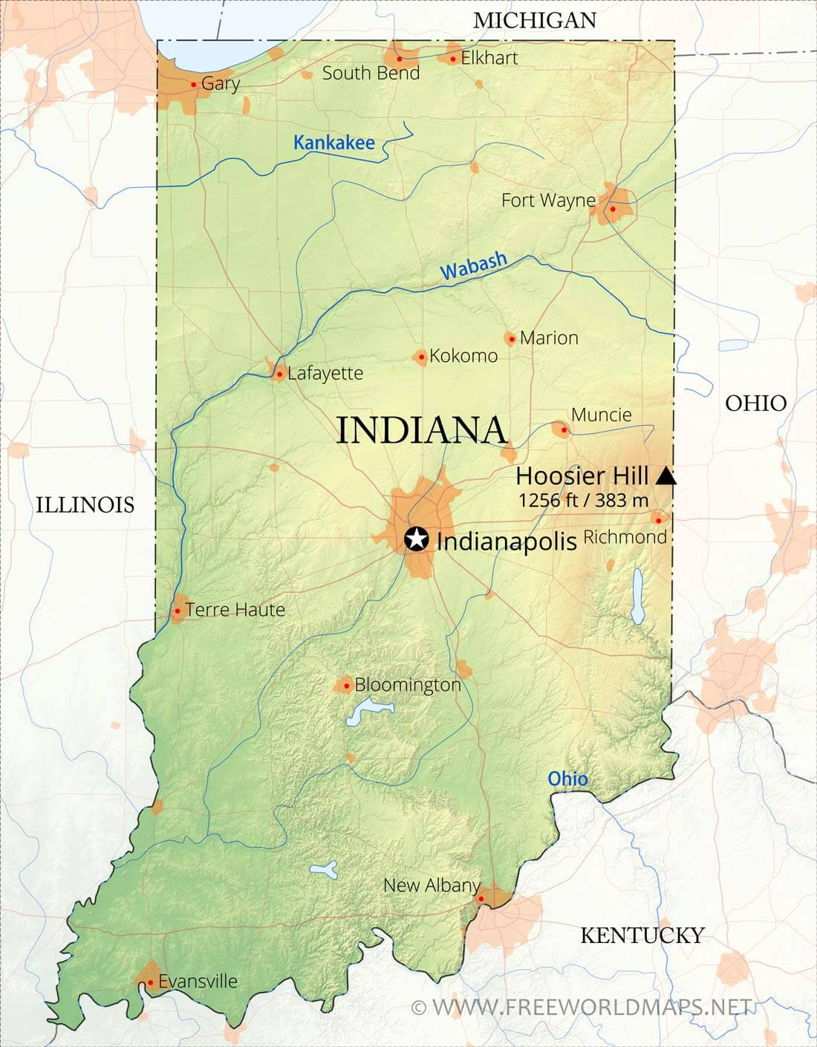


Contribution
Building Infrastructure
Increase efficiency in managing coyotes
➡ By informing the surrounding farms to prevent damage,
using the frequency that coyotes dislike.
Reduce livestock, human costs, and crops damage
➡ By commercialization of coyote detection technology

Slide 28




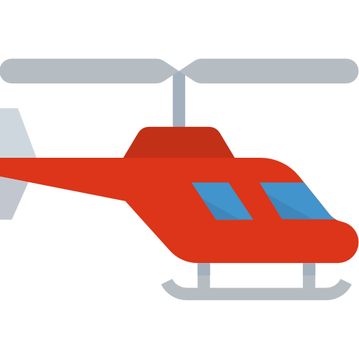
Discussion
💡 Noise-containing dataset for realistic
Synthesize
Nature Environmental Sound – wind, siren, car sound …
Animal Howling
Excluded from the dataset Loss: ↑ / Accuracy: ↓

Slide 29
References
[1] R. Tischaefer, “Coyotes,” in Wildlife Damage Management Technical Series. USDA. APHIS, 2020, p. 42.
[2] K. J. Piczak, “Environmental sound classification with convolutional neural networks,” in 2015 IEEE 25th international workshop on machine learning for signal processing (MLSP). IEEE, 2015, pp. 1–6.
[3] M. Valenti, A. Diment, G. Parascandolo, S. Squartini, and T. Virtanen, “Dcase 2016 acoustic scene classification using convolutional neural networks.” in DCASE, 2016, pp. 95–99.
[4] H. Xu, L. Lin, X. Sun, and H. Jin, “A new algorithm for auditory feature extraction,” in 2012 International Conference on Communication Systems and Network Technologies. IEEE, 2012, pp. 229–232.
[5] M. Ramashini, P. E. Abas, K. Mohanchandra, and L. C. De Silva, “Robust cepstral feature for bird sound classification,” International Journal of Electrical and Computer Engineering, vol. 12, no. 2, p. 1477, 2022.
[6] X. Valero and F. Alias, “Gammatone cepstral coefficients: Biologically inspired features for non-speech audio classification,” IEEE Transactions on Multimedia, vol. 14, no. 6, pp. 1684–1689, 2012.
[7] W. Xu, X. Zhang, L. Yao, W. Xue, and B. Wei, “A multi-view cnn-based acoustic classification system for automatic animal species identification,” Ad Hoc Networks, vol. 102, p. 102115, 2020.
[8] D. Bonet-Sol`a and R. M. Alsina-Pag`es, “A comparative survey of feature extraction and machine learning methods in diverse acoustic environments,” Sensors, vol. 21, no. 4, p. 1274, 2021

Slide 30
References
[9] D. M. Agrawal, H. B. Sailor, M. H. Soni, and H. A. Patil, “Novel teo-based gammatone features for environmental sound classification,” in 2017 25th European Signal Processing Conference (EUSIPCO). IEEE, 2017, pp. 1809–1813.
[10] J. Xie, K. Hu, M. Zhu, J. Yu, and Q. Zhu, “Investigation of different cnn-based models for improved bird sound classification,” IEEE Access, vol. 7, pp. 175 353–175 361, 2019.
[11] S. Kahl, T. Wilhelm-Stein, H. Hussein, H. Klinck, D. Kowerko, M. Ritter and M. Eibl, “Large-scale bird sound classification using convolutional neural networks.” vol. 1866, 2017.
[12] M. Hossin and M. N. Sulaiman, “A review on evaluation metrics for data classification evaluations,” International journal of data mining & knowledge management process, vol. 5, no. 2, p. 1, 2015.
[13] Sprengel, Elias, et al. Audio based bird species identification using deep learning techniques. No. CONF. 2016.
[14] Xie, Jie, and Mingying Zhu. "Handcrafted features and late fusion with deep learning for bird sound classification." Ecological Informatics 52 (2019): 74-81.
[15] Macaulay Library, 27-Sep-2022. [Online]. Available: https://www.macaulaylibrary.org/.
[16] J. Willard Marriott Digital Library. [Online]. Available: https://collections.lib.utah.edu/.
[17] “AudioSet,” Google. [Online]. Available: https://research.google.com/audioset/ontology/dog.html.

Slide 31
References
[18] “Acoustic atlas: Montana State University MSU Library,” Acoustic Atlas: Montana State University Library. [Online]. Available: https://acousticatlas.org/index.php.
[19] “Birdclef 2021 - birdcall identification,” Kaggle. [Online]. Available: https://www.kaggle.com/c/birdclef-2021.

Slide 32
Q & A

Slide 33
Thank You

